Slide 1
Differences

Slide 2
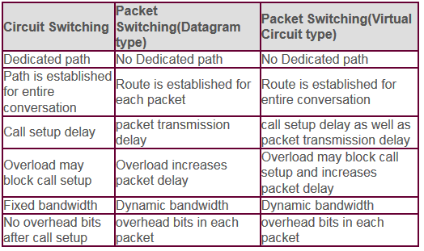
Circuit Switching and Packet Switching

Slide 3
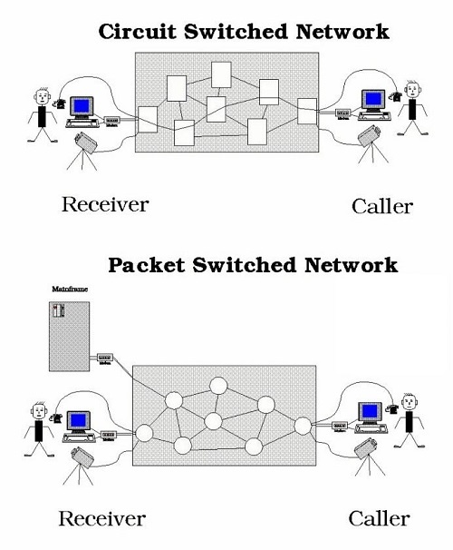

Slide 4
Comparison Between LAN WAN and MAN
BASIS OF COMPARISON | LAN | MAN | WAN
Expands to | Local Area Network | Metropolitan Area Network | Wide Area Network
Meaning | A network that connects a group of computers in a small geographical area. | It covers relatively large region such as cities, towns. | It spans large locality and connects countries together. Example Internet.
Ownership of Network | Private | Private or Public | Private or Public
Design and maintenance | Easy | Difficult | Difficult
Propagation Delay | Short | Moderate | Long
Speed | High | Moderate | Low
Fault Tolerance | More Tolerant | Less Tolerant | Less Tolerant
Congestion | Less | More | More
Used for | College, School, Hospital. | Small towns, City. | Country/Continent.

Slide 5
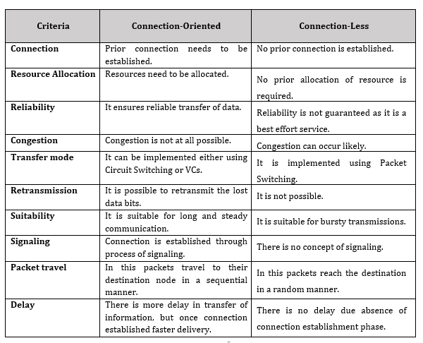

Slide 6
Comparison between Frame and Packet
BASIS FOR COMPARISON | FRAME | PACKET
Basic | Frame is the data link layer protocol data unit. | Packet is the network layer protocol data unit.
Associated OSI layer | Data link layer | Network layer
Includes | Source and destination MAC address. | Source and destination IP address.
Correlation | Segment is encapsulated within a packet. | Packet is encapsulated within a frame.

Slide 7
Comparison between Stop and wait and sliding window Protocol
BASIS FOR COMPARISON | STOP-AND-WAIT PROTOCOL | SLIDING WINDOW PROTOCOL
Behaviour | Request and reply | Simultaneous transmit
Number of transferrable frames | Only one | Multiple
Efficiency | Less | More comparatively
Acknowledgement | Sent after each arriving packet | Window of acknowledgement is maintained
Type of transmission | Half duplex | Full duplex
Propagation delay | Long | Short
Link utilization | Poor | Better

Slide 8
Comparison between Go back-N and Selective Repeat
BASIS FOR COMPARISON | GO-BACK-N | SELECTIVE REPEAT
Basic | Retransmits all the frames that sent after the frame which suspects to be damaged or lost. | Retransmits only those frames that are suspected to lost or damaged.
Bandwidth Utilization | If error rate is high, it wastes a lot of bandwidth. | Comparatively less bandwidth is wasted in retransmitting.
Complexity | Less complicated. | More complex as it require to apply extra logic and sorting and storage, at sender and receiver.
Window size | N-1 | <= (N+1)/2

Slide 9
Comparison between Go back-N and Selective Repeat
Sorting | Sorting is neither required at sender side nor at receiver side. | Receiver must be able to sort as it has to maintain the sequence of the frames.
Storing | Receiver do not store the frames received after the damaged frame until the damaged frame is retransmitted. | Receiver stores the frames received after the damaged frame in the buffer until the damaged frame is replaced.
Searching | No searching of frame is required neither on sender side nor on receiver | The sender must be able to search and select only the requested frame.
ACK Numbers | NAK number refer to the next expected frame number. | NAK number refer to the frame lost.
Use | It more often used. | It is less in practice because of its complexity.

Slide 10
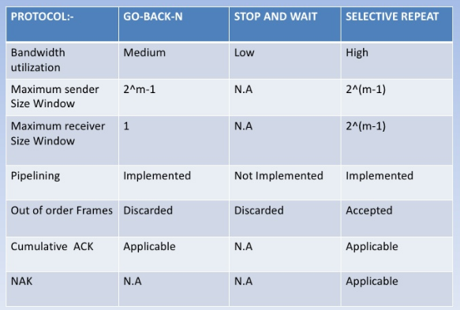
Comparison

Slide 11
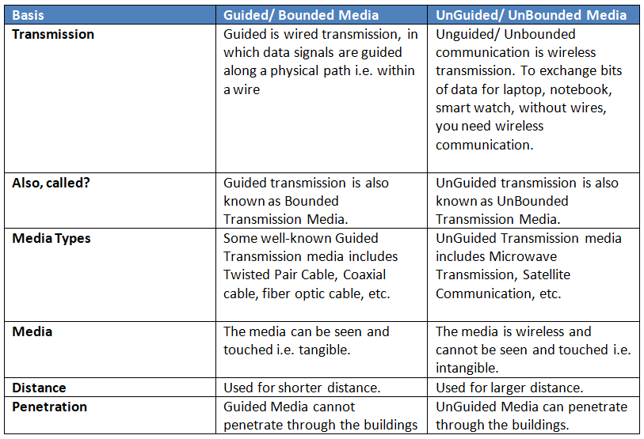

Slide 12
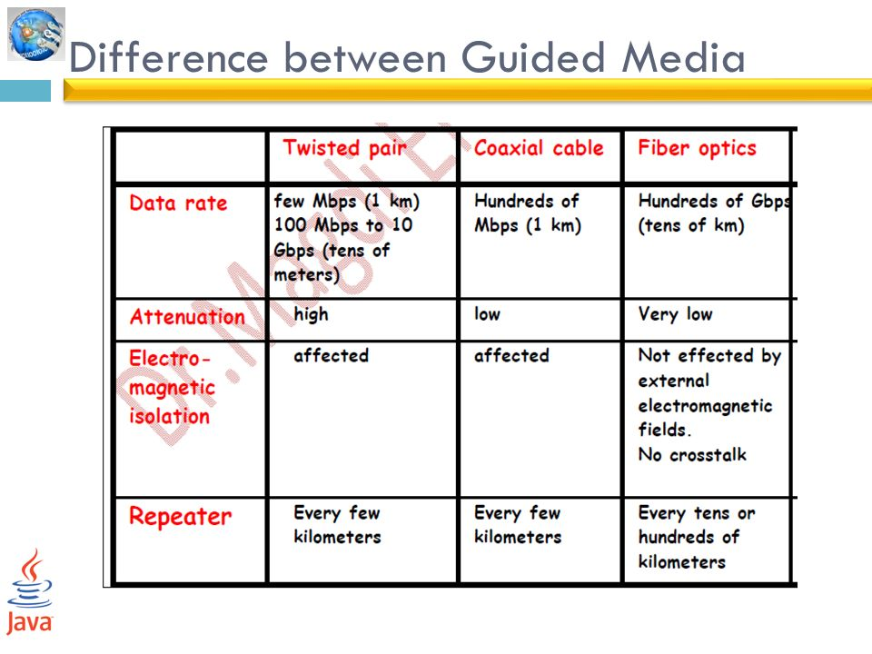

Slide 13
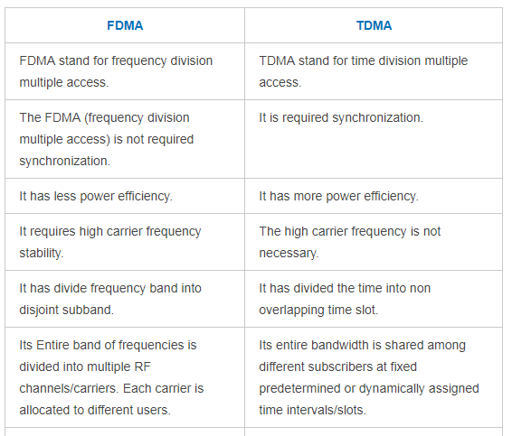

Slide 14
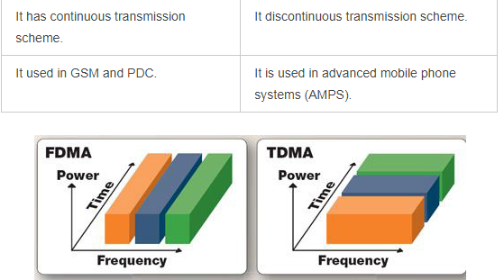

Slide 15
